Slide 1


Mobile Testing
Software Quality Assurance
Telerik Software Academy
http://academy.telerik.com

Slide 2


Lectors
Dimitar Topuzov Principal QA Engineer @NativeScript Team
Miroslava Ivanova Senior QA Engineer @iOS Team

Slide 3

Table of Contents
Types of mobile apps
Native / Hybrid / Mobile Web
Challenges testing mobile apps
Device and OS fragmentation
Tooling is still not as mature as tooling for Web Testing

Slide 4
Table of Contents
Automation tools
Based on accessibility APIs
Based on image recognition
Based on instrumentation of app under test
Demos
Testing native iOS apps with Xcode
Testing native Android apps with Appium

Slide 5
Mobile Apps
Native applications
Can take full advantage of all the device features – camera, GPS, accelerometer, compass and so on
Available at application store (such as Google Play or Apple’s App Store)
Usually developed as separate app for each platform (Java for Android and ObjectiveC or Swift for iOS)
Recently some vendors provide frameworks for cross platform native mobile development, for example: Xamarin, ReactNative, NativeScript

Slide 6
Mobile Apps
Hybrid applications
Hybrid apps are part native apps, part web apps
Live in an app store and can take advantage of the many device features
Rely on HTML being rendered in a browser embedded within the app
Allow cross-platform development and thus significantly reduce development costs

Slide 7
Mobile Apps
Mobile web applications
A web app is an app written in web code that is similar to a website but more interactive so it feels like an app on mobile devices
A web app is typically the most inexpensive option
Cannot be distributed through native app stores like the App Store or Google Play

Slide 8
Summary Table
 | Native | Hybrid | HTML5
App Features
Graphics | Native APIs | HTML, Canvas, SVG | HTML, Canvas, SVG
Performance | Fast | Slow | Slow
Native look and feel | Native | Emulated | Emulated
Distribution | AppStore | AppStore | Web
Device Access
Camera | Yes | Yes | No
Notifications | Yes | Yes | No
Contacts, calendar | Yes | Yes | No
Offline storage | Secure file storage | Secure file system, shared SQL | Shared SQL
Geolocation | Yes | Yes | Yes
Gestures
Swipe | Yes | Yes | Yes
Pinch, spread | Yes | Yes | No
Connectivity | Online and offline | Online and offline | Mostly online
Development skills | ObjectiveC, Java | HTML5, CSS, JavaScript | HTML5, CSS, JavaScript

Slide 9
Mobile Testing Challenge
Fragmentation of mobile devices
40+ iOS devices
18K+ Android devices
Different hardware and screen sizes
Different network types (2G, 3G, 4G or WIFI)
Different OS
Android
iOS
Windows

Slide 10
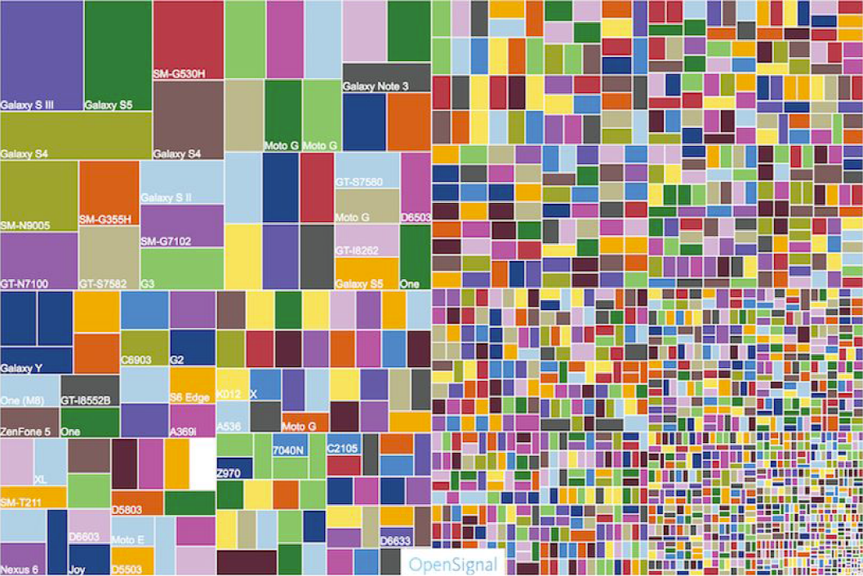
Mobile Testing Challenge
Fragmentation of Android devices in picture
Notes:
For more details visit:
http://opensignal.com/reports/2015/08/android-fragmentation/

Slide 11
Mobile Testing Challenge
New Capabilities to test
Camera, GPS, voice
Data and power consumption
Wearables
Quality is critical
User experience is key to brand perception
You can’t delete negative customer reviews in the App Store/Google Play

Slide 12
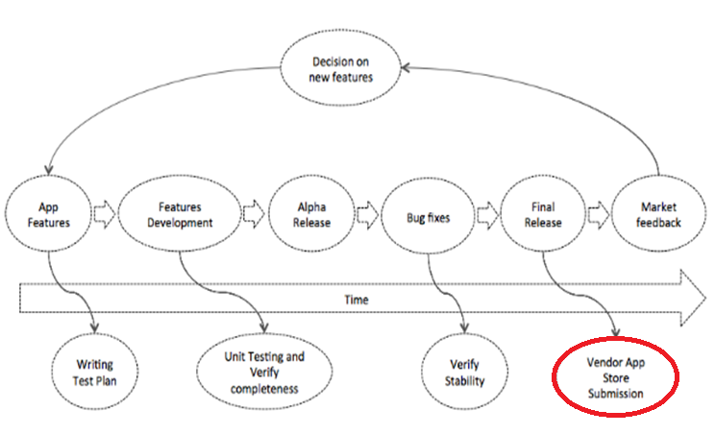
Mobile Testing Challenge
Typical phases in mobile application testing
Key difference: Apps needs approval for App Stores

Slide 13
Mobile Testing Challenge
Devices are not as stable as PCs
Test tooling is not as mature as tooling for Web/Desktop testing
Cross-platform testing is hard (even with cross-platform tools)
Different UI controls
Different accessibility in different OS
Different behavior of Device/Emulator in different OS versions
Different limitations for Devices/Simulators

Slide 14

Mobile Testing Challenge
The Big Question – Emulators vs. Real Devices

Slide 15
Mobile Testing Challenge
Android Emulator
Android emulator run ARM (or x86) CPU virtual machine, with all the software stack on top of it - Linux kernel, Android system image, etc
Think of it as an emulated hardware
iOS Simulator
Runs native code, directly on your CPU, does not emulate an iPhone processor, disk drive, memory constraints
The project is recompiled for architecture of your Mac (not architecture of your iOS phone)
Simply emulates all the iOS APIs

Slide 16
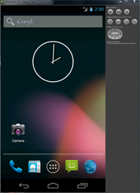
Mobile Testing Challenge
Emulators benefits
Faster (if accelerated)
Easy and cheap way to simulate
Different resolutions
Different OS versions
Low battery
Low memory

Slide 17
Mobile Testing Challenge
Emulators disadvantage
0% of real users use emulators
Hardware is different
Emulators are not a good option for testing
Performance
Sensor related things (camera, location, accelerometer)
File level access operations and storage

Slide 18
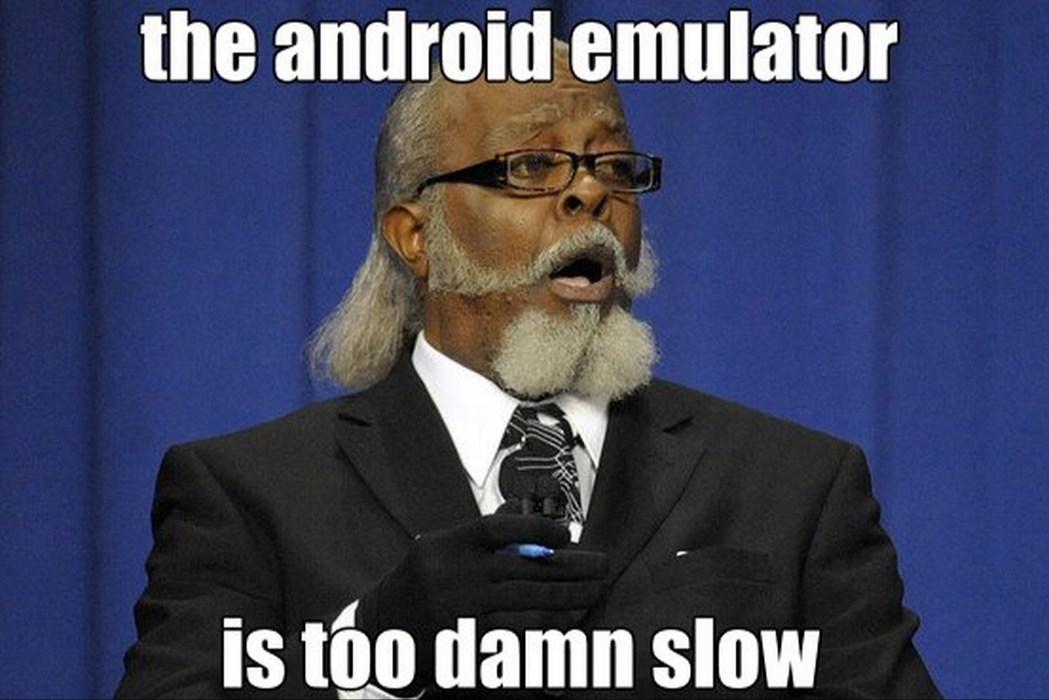
Mobile Testing Challenge
Android Emulators
Use Intel HAXM and x86 images to speed up the emulator

Slide 19
Mobile Testing Tools
Image based approaches
Sikuli
Native automation APIs (or wrappers around them)
iOS: Frank, KIF
Android: Robotium, Espresso, Selendroid
Cross-platform solutions based on native automation APIs
Calabash
Appium
Cross-platform solutions based on instrumentation
Telerik Mobile Testing

Slide 20

Device Cloud
What is a device cloud?
Providers
Sauce Labs
Bitbar
Etherios
Xamarin cloud
(soon) Google

Slide 21

iOS Demo

Slide 22
Xcode UI Testing
UI Testing for iOS
Find and interact with UI elements
Validate UI properties and states
Recording
Requirements
UI testing depends on new OS features
iOS 9, OS 10.11
iOS devices

Slide 23
XCTest
Test case subclasses
Test methods
Assertions
Integrated with Xcode
CI via Xcode Server and xcodebuild
Support Swift and Obective C

Slide 24
APIs
XCUIApplication
proxy for the application you are testing
XCUIElements
proxy for the UI Elements for the application
XCUIElementsQuery
you use element queries when you want to find elements

Slide 25
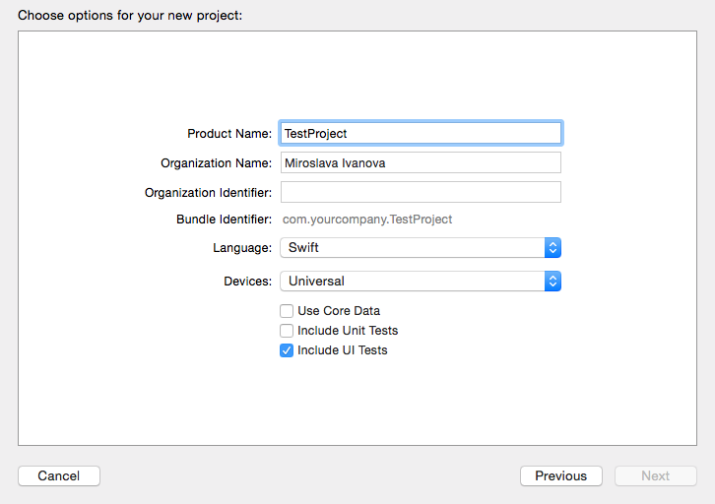
Xcode 7
Include your UI Tests

Slide 26
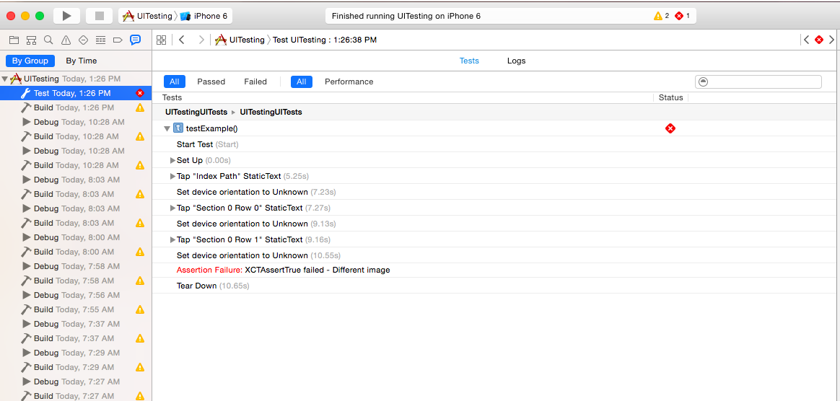
Xcode 7

Slide 27

Android Demo

Slide 28
Appium
Appium is an open-source tool for automating native, mobile web, and hybrid applications on iOS and Android platforms
Appium Philosophy
Do not modify app under test
Write tests using any modern language and testing framework
Do not reinvent the wheel when it comes to automation APIs
Open source

Slide 29
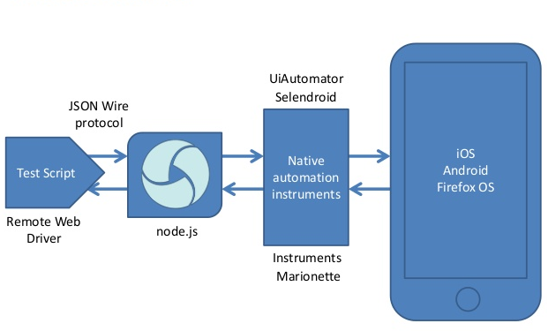
Appium
Appium Architecture

Slide 30
Inspect UI
Inspectors
Appium Build-in inspector
RichUI
Inspect both Android and iOS
Can use it like playground for testing locators
Basic record/replay available
Available only for OSX
Android UIAutomatorViewer
Inspect only Android
Available for all OSs

Slide 31
Lessons Learned
Avoid mobile testing ☺
It is hard, it is slow and it is flaky
Forget about Windows (if possible)
iOS usually can be tested only from OSX
A lot of tools are not available for Windows
Get powerful hardware
Execution time (specially for emulators) improves a lot with SSD and fast CPU/RAM
Run some tests on real devices
Remember – 0% of real users use emulators

Slide 32
Mobile Testing
?
?
?
?
?
Questions?
?
?
?
?
?
?

